Slide 1
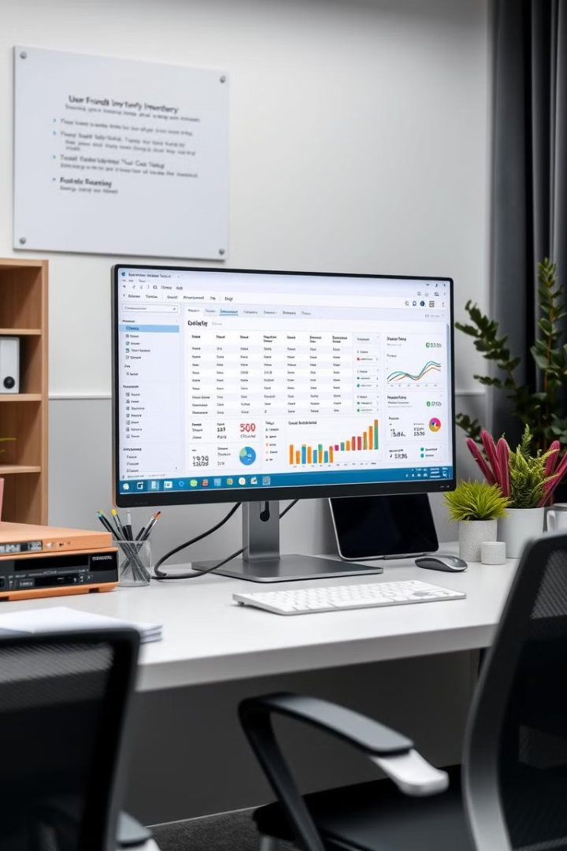
Inventory Management System
This presentation outlines the development and implementation of an Inventory Management System (IMS) designed to streamline inventory management processes for businesses.
Submitted By:
Muhammad Danial (233588)
Musa bin Abdullah (233576)
Abdullah Altaf (233558)
Submitted To:
Madam Atika Ali
Bs Computer Science (B)

Slide 2
Project Overview
Problem Statement
Solution
Manual inventory management is inefficient and prone to errors, especially for businesses with large quantities of products and customers.
This project aims to address these issues by providing an automated, user-friendly inventory management system built using C# and WPF.

Slide 3
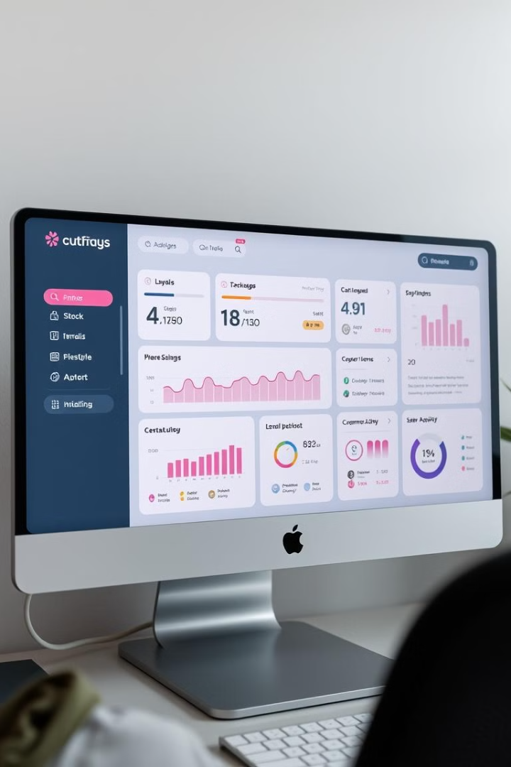
System Features
Core Functionalities
Innovative Aspects
Authentication, customer management, product management, sales management, dashboard, audit logs, and barcode generation.
Advanced sales analytics, integrated barcode generation, and comprehensive audit logs for user accountability.

Slide 4
Business Logic
Core Logic
Problem-Solving Approach
The system leverages a database to store and retrieve inventory, customer, and sales data. Core logic includes authentication, inventory management, and barcode generation.
Modular development for scalability, WPF for a responsive user interface, C# for efficient backend logic, and SQL Server for reliable data storage.

Slide 5



System Architecture
BaseEntity
1
Inherits common properties.
2
User, Customer, Product, Supplier
3
Sale, Invoice

Slide 6
Implementation Process
Requirement Analysis
1
2
Design
Coding
3
4
Testing
Deployment
5

Slide 7
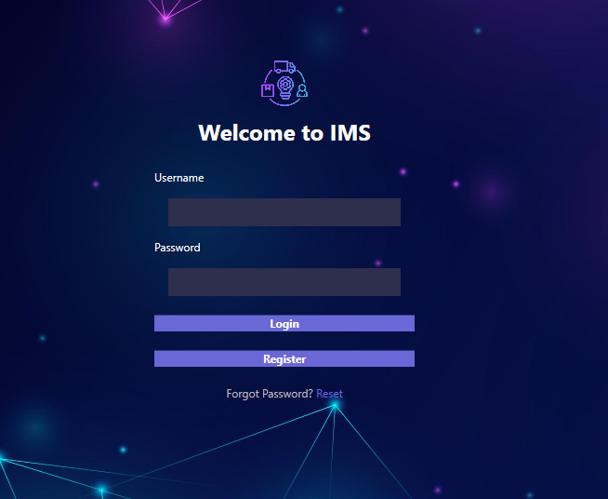
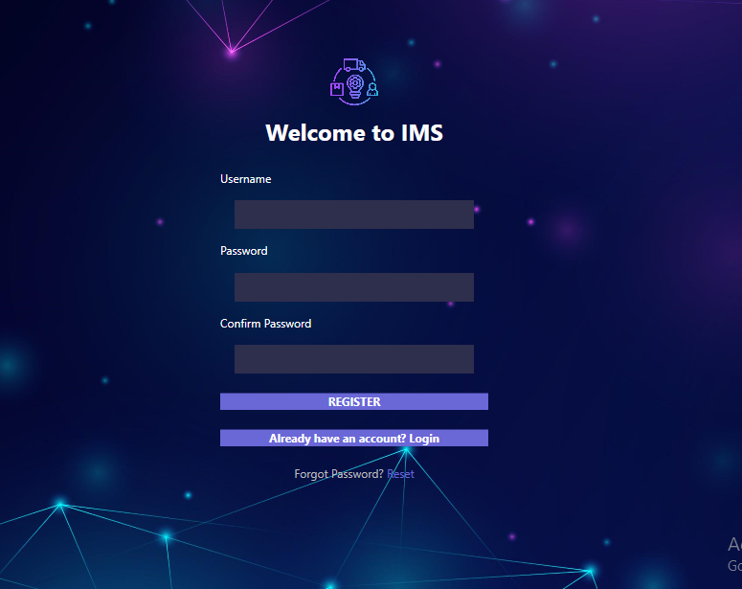
User Interface Design
Login Page

Slide 8
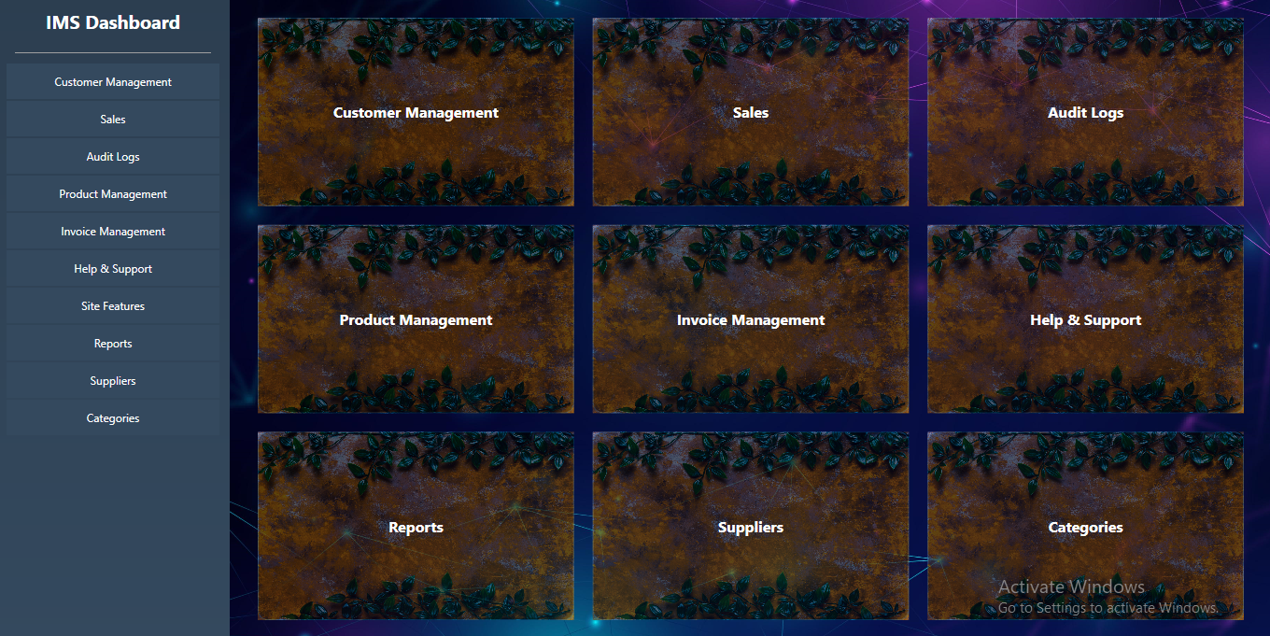
User Interface Design
Dashboard

Slide 9
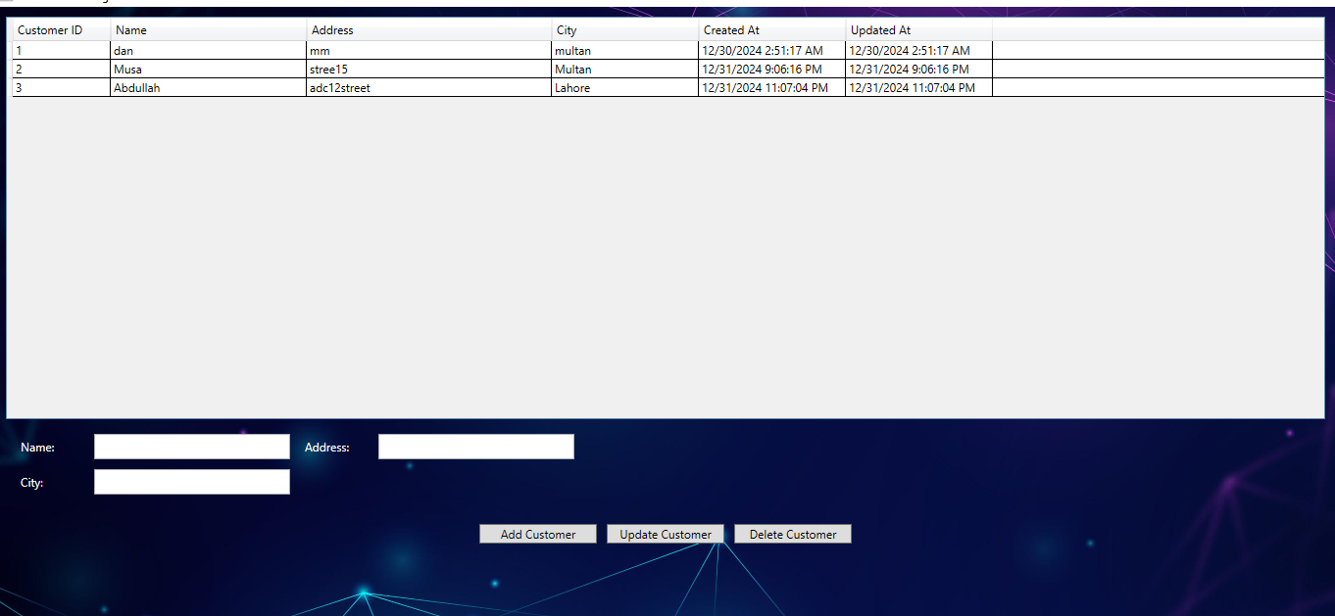
User Interface Design
Customer Management

Slide 10
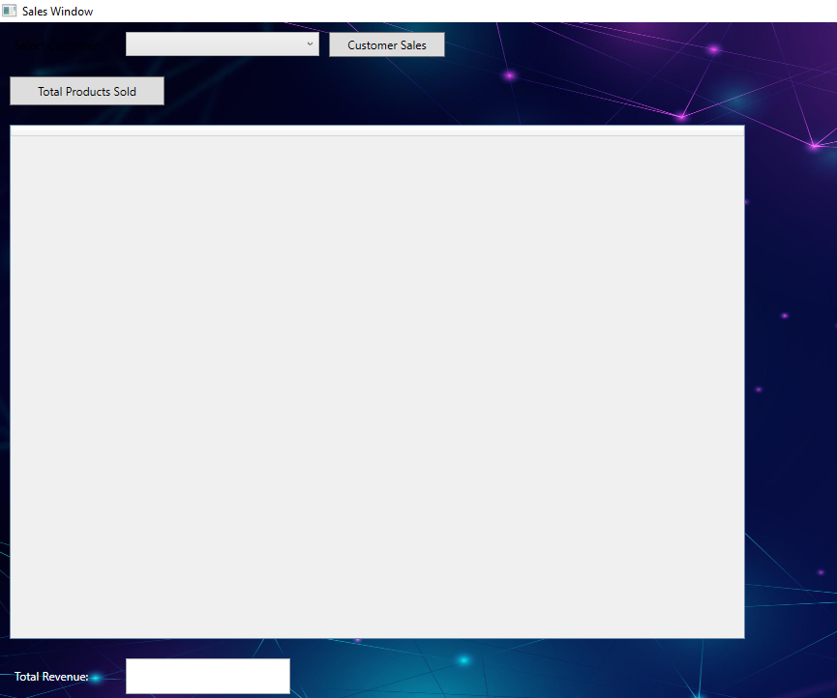
User Interface Design
Sales Window

Slide 11
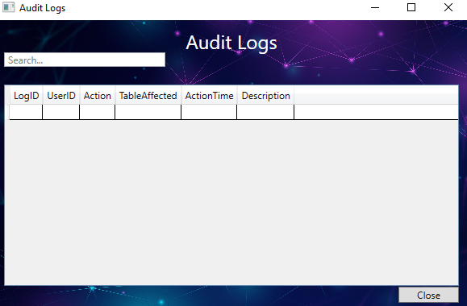
User Interface Design
Audit Log

Slide 12
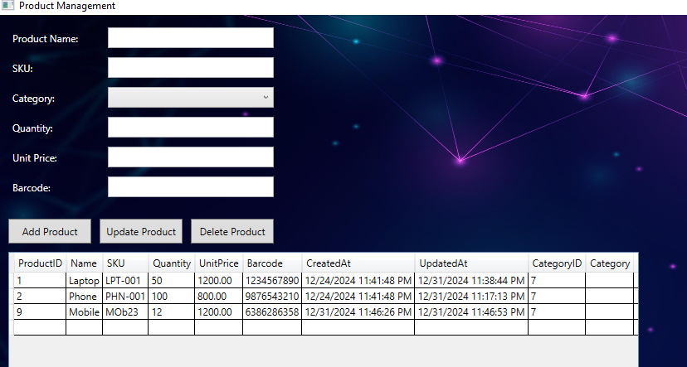
User Interface Design
Product Management

Slide 13
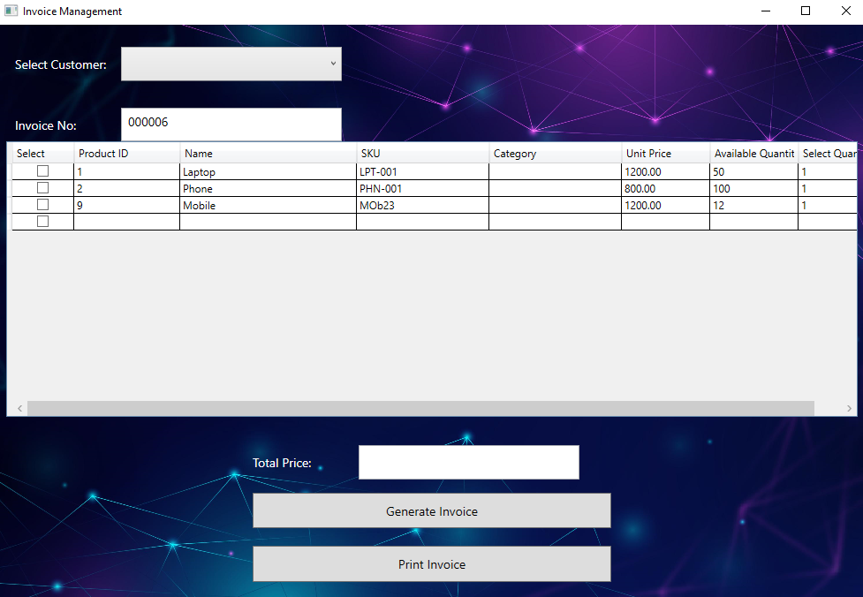
User Interface Design
Invoice Management

Slide 14
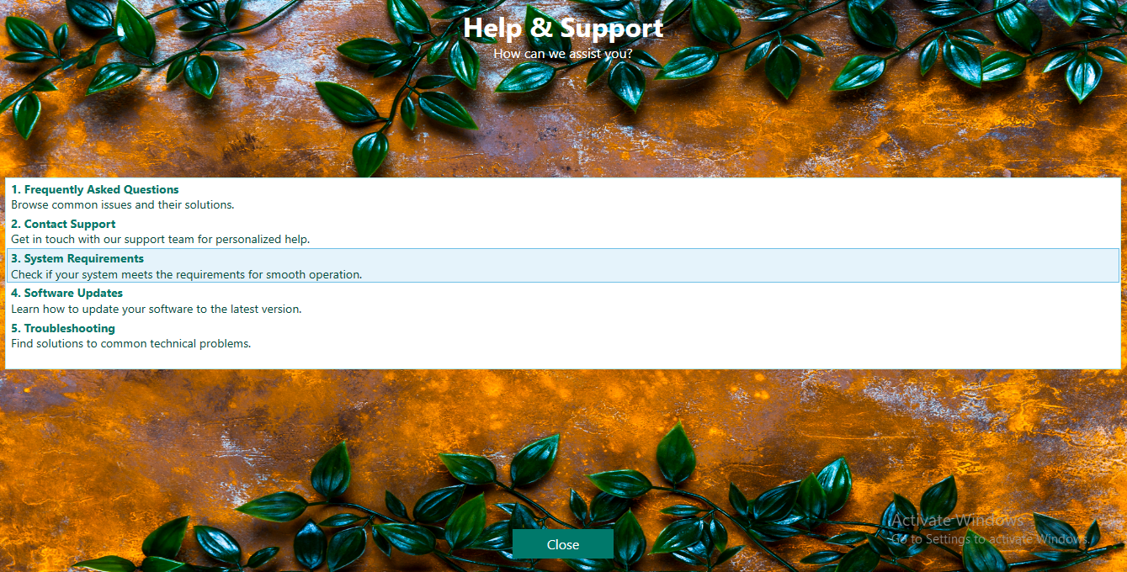
User Interface Design
Help and Support

Slide 15
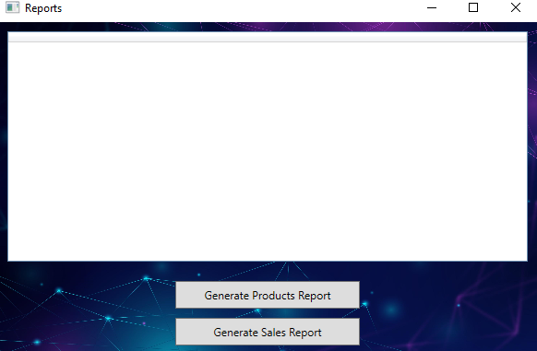
User Interface Design
Reports

Slide 16
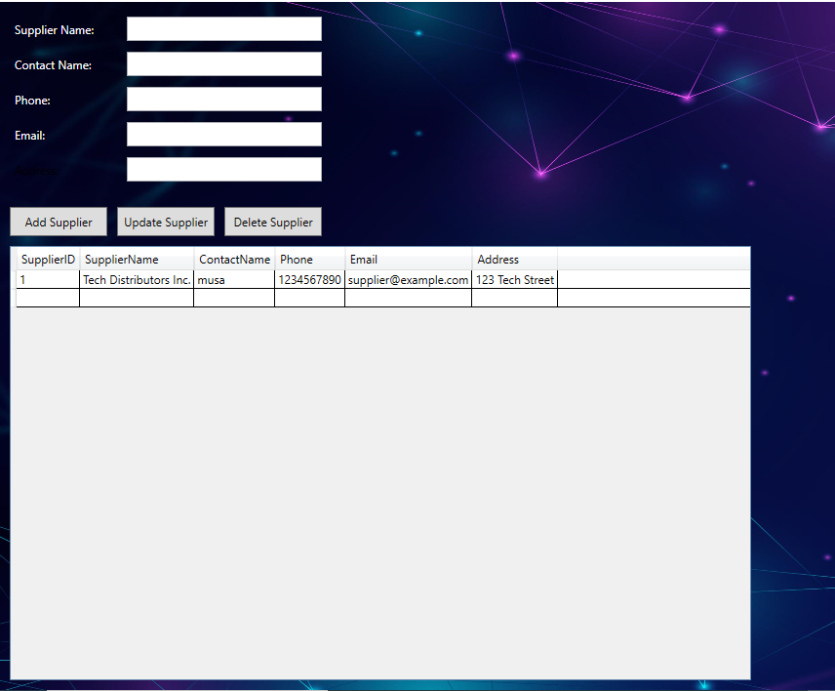
User Interface Design
Supplier

Slide 17
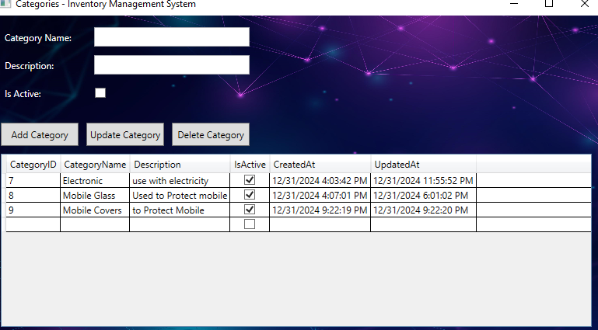
User Interface Design
Categories

Slide 18
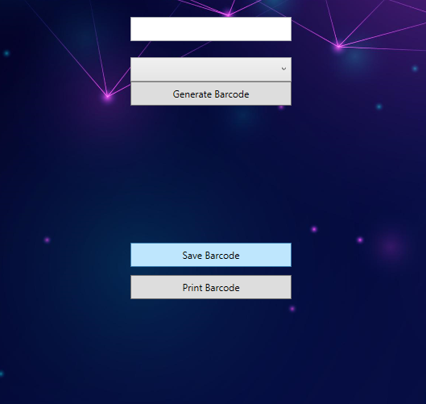
User Interface Design
Site Features

Slide 19

Challenges and Solutions
1
Real-time Sales Tracking
2
Authentication Security
Leveraged SQL Server triggers for real-time updates.
Used password hashing and secure database connections.

Slide 20
Project Outcomes
Objectives Achieved
Future Enhancements
The project achieved its objectives by delivering a feature-rich inventory management system with a user-friendly design and robust backend functionality.
Adding mobile application support, integrating machine learning for predictive analytics, and cloud-based deployment for enhanced accessibility.

Slide 21
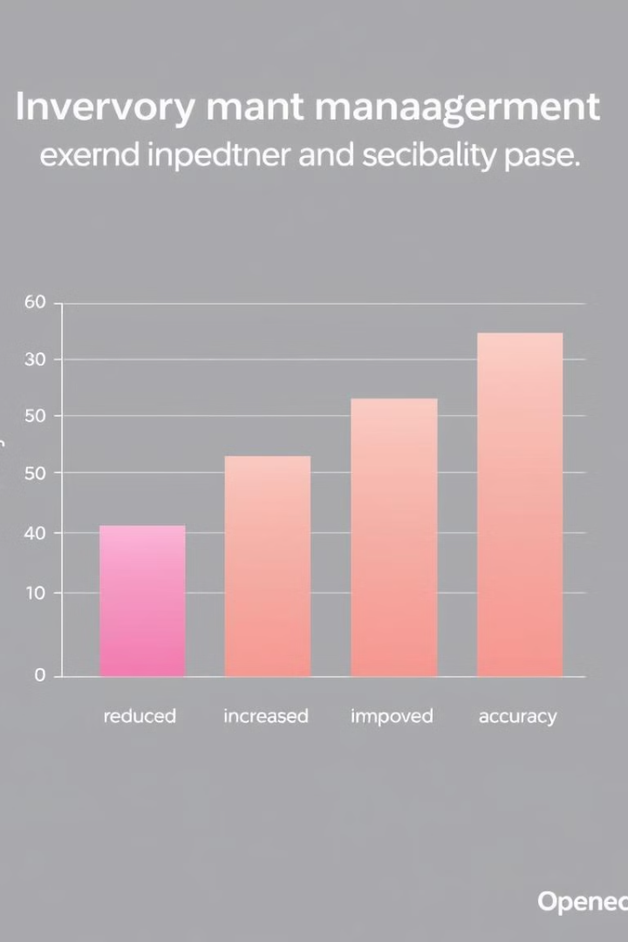
Conclusion
The IMS has demonstrated significant improvements in inventory accuracy and operational efficiency. Users have reported positive feedback on the system's ease of use and reliability. Future enhancements will focus on expanding system capabilities and integrating advanced analytics to further optimize inventory management.

